Slide 1
JOB INTERVIEWS

Slide 2
The Employment Interview
It is a meeting during which both you and the prospective employer ask questions and exchange information.
The employer’s objective is to find the best talent to fill available job openings, and
Your objective is to find the right match for your goals and capabilities.

Slide 3
Series or Sequence of Interviews
Match the following and also state which interview may happen first and so on.
Interview in the Series | Purpose
Selection Interview | To filter out candidates unqualified or not a good fit for the position
Screening Interview | To sell you on the advantages of the job, usually with a higher ranking executive
Final Evaluation Interview | Identifying the top candidates from all who qualify

Slide 4
Series or Sequence of Interviews
Refer to you handout and discuss the strategies you should use for each type of interview in the series.

Slide 5
Types of Employment Interviews
Structured
Vs
unstructured
Panel
Vs
group
Behavioral
Situational
Working
Stress

Slide 6
Types of Interviews-Summary
Structured vs Unstructured
A series of fixed questions vs open-ended questions molded as per the responses given
Panel vs group
Several interviewers in a panel vs a group discussion with other candidates
Behavioral
Questions about specific incidents/experiences from the past

Slide 7
Types of Interviews-Summary
Situational
Questions focus on how you will handle hypothetical situations on the job
Working
You are asked to perform a job related activity during the interview
Stress
To check how well you handle stressful situations

Slide 8
Interview Media
Telephonic
Video conference
Recorded
Mobile Apps

Slide 9
What does the Employer look for in the interview?
Think and Share or go through the handout.

Slide 10
What does the Employer look for in the interview?
Can you handle the responsibilities of the position?
Are you a good fit with the organization and the target position?
Do you have the qualities of a good employee-work ethic, confidence, dedication, positivity, courtesy, commitment, curiosity?
Can you commit to something larger than your own individual goals?
Are you a good fit with the unique culture of the organization?

Slide 11
Matching Skills to Requirements
Employer needs | Your evidence
Communication Team work Leadership Initiative Customer Care IT Commercial awareness | Presentation to class Example of any project Students societies, Committees etc. Fundraising for charity Working in some service. Designed website Business pages

Slide 12
TOP 10 MOST WANTED SKILLS IN INTERVIEW
10. Problem Solving Skills: Employers want to know you can make decisions. You can solve problems.
9. Planning and Organization: You know how to plan and organize your time. Managers want to know you can set goals and reach them.
8. Flexibility and Adaptability: Organizations expect you to be flexible and adaptable. You can manage multiple assignments and tasks, you can set priorities, you can adapt to changing conditions, and work assignments.
7. Interpersonal Skills: You have good interpersonal skills, you have high EQ, you know how to get along with others, and minimize conflict. Employers want to know you can relate to other people and cultures with sensitivity and awareness.
6. Strength of Character: you are honest, you have integrity, loyalty, strength of character. Your supervisor certainly expects you to be trustworthy and honest.

Slide 13
TOP 10 MOST WANTED SKILLS IN INTERVIEW
5. Technical Skills: you have the skills you need to actually perform your work. Firms want you to know you have the skill set to do the job, of course. But that's not all.
4. Teamwork: You can work confidently within a group., You let your voice be heard and respect what others have to say. Because so many jobs involve working in groups, employers want you to be able to work well with others. To fit in with the team.
3. Self-Motivation: You are a self motivated person, you take initiative, you work hard. Organizations don't want people who always have to be told what to do. They want you to take responsibility for your work.
2. Evolutionary Skills: You know how to learn, and how to continually improve. Every potential employer wants to know you can grow and evolve in your work. And now the number one skill that employers are looking for.
1. Communication Skills: you are a clear, concise, and effective communicator. Employers want you to be able to speak and listen effectively.

Slide 14
Preparing for the Interview
Three stages
Pre- interview preparation
During interview performance
Post-interview protocols

Slide 15
Preparing for the Interview
Research the position/career-duties, responsibilities, skills needed, qualifications needed, knowledge required, possible career path, market demand, importance if the profession
Research the organization-mission, vision, company’s operations and market standing, needs, strategic and tactical challenges faced, culture, values
Research about the people in the company-their designation, experience, expectations, career achievements
Know your Knowledge, Skills, Abilities and Accomplishment, Relate your KSAs to the position for which you are applying

Slide 16
Preparing for the Interview
Prepare answers to typically asked interview questions
Prepare your own questions
Calm your nerves-focus on your strengths, value, abilities, and suitability
Rehearse for the interview-with a friend, software, or record yourself and analyze your strengths and work on weaknesses

Slide 17

For Men
Suit, two-piece matching
Navy, dark grey, black, conservative solids or pinstripe
Wool or wool blends
Silk tie, no extremes
Long sleeved shirts in white or light blue; solid or conservative stripes
Leather, lace-up or slip-on business shoes in black, brown, cordovan-polished!

Slide 18
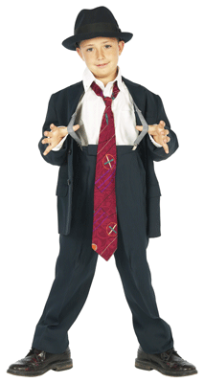
For Men
Belt should match shoes!
Hair well-groomed
Conservative watch and other jewelry
Removing earrings is safest
Do not leave the tags on outside of apparel
Long socks to match color of suit – no white tube socks!

Slide 19
For Women
Decent and modest dressing
Business colors for Shirts-blue, grey, white, beige, earthly tones
Trousers/Stolers-black, white, off-white, beige
Formal jewelry (one ring/bracelet, small earrings, no necklace/chain) and watch
Hair-well-put together (no complicated styling)

Slide 20


For Everyone
Hair should be neat and clean
Shoes should be in good condition
Clean fingernails
Clothes should fit properly
Use appropriate deodorant
Everything clean and well-pressed
Slim leather briefcase if needed

Slide 21
Final Look-The brand you
Exhibit warmth, wit, intelligence, charm
Be poised, elegant, well-mannered
Rehearsed and prepared

Slide 22

Beginning the Interview
Firmly shake hands with those you meet
Greet all involved in the interview process and try to remember names
Be friendly to everyone (secretaries, other employees, etc.)
Follow the interviewer’s lead (direction, selecting a seat, drink, etc.)

Slide 23





Posture During the Interview
Sit on the front third of the seat
Men: legs uncrossed, but closed
Women: legs may be uncrossed and tilted to right
Hands folded in front
Sit up straight with head, neck, and chest aligned with hips
Be careful of bad habits
Tapping your fingers
Biting your nails
Playing with your hair
Clicking your pen, etc.

Slide 24
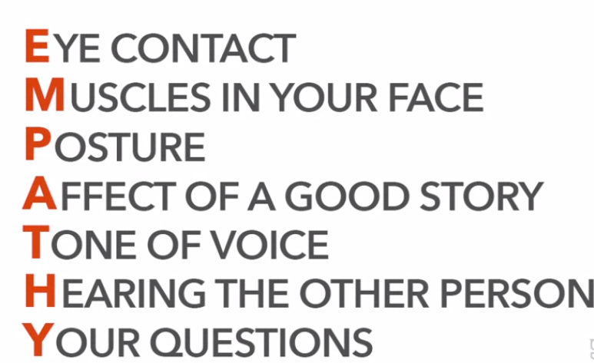
EMPATHY

Slide 25
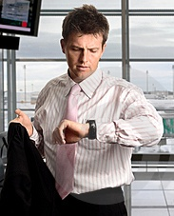



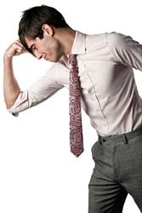

During the Interview
Be on time
Be friendly
Show willingness to answer questions
Be positive and honest
Maintain eye contact
Think and answer
Don’t criticize previous employers
Be aware of body language
Be a good listener
Emphasize your strengths
Be yourself
Don’t appear distracted observing the room, furniture, etc.
Be confident
Discuss ways you can contribute

Slide 26
During the Interview
RELAX!
Answer the questions using the “PROVE IT” Method (give specific examples-behavioral interviewing)
Ask intelligent questions about the organization
Don’t volunteer negative information about yourself
Be honest
Have eye contact with the interviewer
Say positive things about your former supervisors and working conditions
Find ways to let the interviewer know you are a team player

Slide 27
Asking Your Own Questions
At some point in the interview, usually near the end, you will be asked whether you have any questions. The worst thing you can do is say No, which suggests that you are not interested in the position. Instead, ask questions that will help you gain information and will impress the interviewer with your thoughtfulness and interest in the position.
1. What will my duties be (if not already discussed)?
2. What it is like working here in terms of the people, management practices, workloads, expected performance, and rewards.
3. What training programs are available from this organization? What specific training will be given for this position?
4. Who would be my immediate supervisor?
5. What is the organizational structure, and where does this position fit in?

Slide 28
6. When do you expect to make a decision?
7. Is travel required in this position?
8. How is job performance evaluated?
9. Assuming my work is excellent, where do you see me in five years?
10. How long do employees generally stay with this organization?
11. What are the major challenges for a person in this position?
12. What do you see in the future of this organization?
13. May I have a tour of the facilities?

Slide 29
How to Answer
Listen carefully, seek clarification
Illustrate answers with real examples and evidence
Be positive – constructive criticism
Keep answers specific and succinct
Take time to respond
Be alert to interviewer’s body language
Speak clearly, smile and show enthusiasm
Know what you want to say, and find the opportunity

Slide 30
Responding to Competency Questions
Q. Give me an example of a problem you encountered. How did you approach it. What was the outcome?
STAR response
S: Describe the situation
T: Explain the task/problem that arose
A: What action did you take?
R: What was the result or outcome?
What did you learn from this experience?

Slide 31
AFTER THE INTERVIEW
Thanking Your Interviewer
Contacting Your References
Following Up
If you don’t hear from the interviewer within five days, or at the specified time, call him or her.
Practice saying something like,
“I’m wondering what else I can do to convince you that I’m the right person for this job, or, I’m calling to find out the status of your search for the ____________ position. “
You could also e-mail the interviewer to find out how the decision process is going.
It is important to sound professional and courteous. Sounding desperate, angry, or frustrated that you haven’t been contacted can ruin your chances.
The following follow-up e-mail message would impress the interviewer:”

Slide 32
For example
Dear Ms. Jamison:
I enjoyed my interview with you last Thursday for the receptionist position.
You should know that I’m very interested in this opportunity with Coastal Enterprises. Because you mentioned that you might have an answer this week,
I’m eager to know how your decision process is coming along. I look forward to hearing from you.
Sincerely,

Slide 33
Typical Questions
About you
Tell me about yourself - Bring me up to date with your CV?
Why did you choose that particular degree programme?
What experience have you had that is relevant to this post?
What would you consider your major achievements to date?
About the job
What interests you about this job?
What do you know about this organisation?
What other options are you considering?
How do you see your career developing – 5 years?
If you were Head of Department, what would be your priorities?
General Questions
What do you think of the Government’s policy on college fees?
What would you prefer, a very good salaray package or the work environment?

Slide 34
Other Type of Questions
“What if” Questions
No experience - how are you likely to respond to a situation
Probing Questions
How exactly did you deal with the situation?
How did you know it worked?
How did you feel about the outcome?
Could you have handled it differently?

Slide 35
Questions that should be avoid
Never answer the questions such as,
Any question which reveals your age, ethnicity, religious beliefs
Any question leading to any social issue
Your thoughts on feminism
Your personal opinion on some controversial matter such as, politics
Your personal life (marriage, children)
Your thoughts on working with the opposite gender at the work place
Family status (about family in general)
Health

Slide 36
NOTE!
Read the chapter in the handout
Read the responses to the commonly asked interview questions

